Slide 1

Project Title –Telecom Churn Analysis
-BUDIDA SOWMYA

Slide 2

PROBLEM STATEMENT
Telecom operators constantly face customer churn due to increased competition, service dissatisfaction, and evolving customer needs. Churn directly impacts profitability, and identifying customers at risk remains a major challenge.
This project focuses on analysing customer data to:
Predict which customers are likely to churn using analytical and machine learning techniques.
Identify the key drivers of churn, including usage behaviour, customer demographics, and service quality indicators.
Provide insights and recommendations that can help design proactive retention strategies.
By developing an accurate churn prediction model, the organization can reduce customer loss, improve service quality, and optimize marketing efforts for high-risk customers.

Slide 3
Project Description
Telecommunication companies lose a significant number of customers every month due to factors such as poor network experience, high billing charges, attractive competitor offers, or lack of personalized services. This customer loss, known as churn, directly impacts revenue and increases the cost of acquiring new users.
Although telecom providers collect large amounts of customer data—usage patterns, billing history, complaints, demographics, and service interactions—they often lack the analytical capability to predict churn early and understand why customers are leaving. Without timely insights, retention teams cannot take proactive actions to prevent churn.
This project aims to analyse the available customer data to detect churn patterns, identify high-risk customers, and discover the main drivers of churn. The outcome will help the organization develop targeted interventions, improve customer satisfaction, and reduce churn rates.

Slide 4

WHO ARE THE END USERS?
Customer Retention Teams – Use churn predictions to create proactive retention campaigns.
Marketing Teams – Design targeted offers and personalized plans for high-risk customers.
Customer Experience (CX) Teams – Improve service quality and address issues leading to churn.
Business Strategy & Leadership – Make data-driven decisions to reduce churn and improve revenue.
Analytics & Data Science Teams – Monitor model performance and generate insights for the busines

Slide 5

Technology Used
  Google Colab
  Python
  Numpy
  Seaborn
  Matplotlib

Slide 6
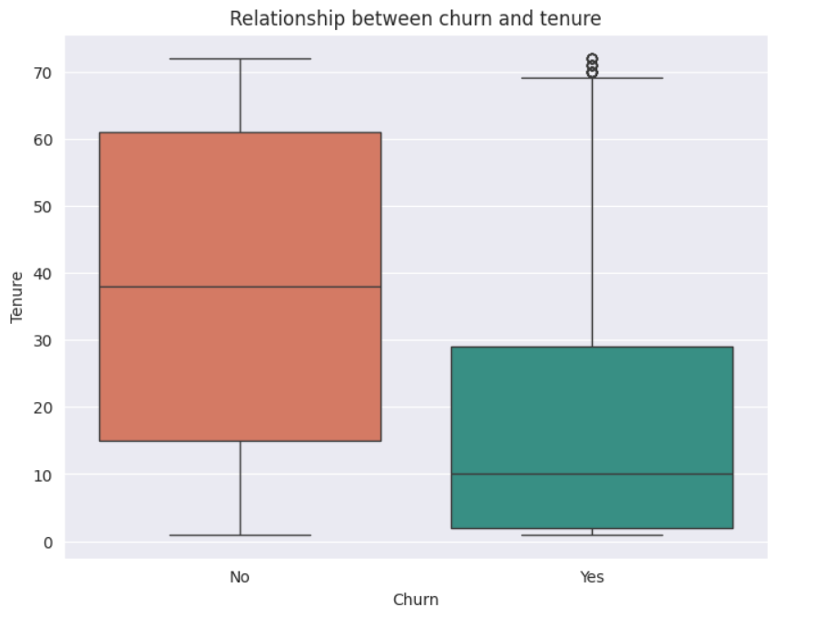
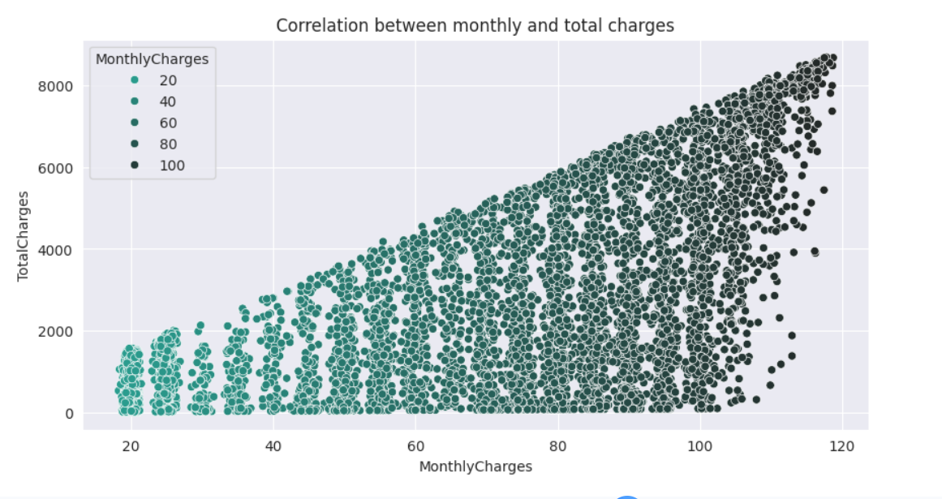
RESULTS
[Add screen shots of your code ]
GITHUB LINK: https://github.com/sowmyabudida4565/Telecom-Churn-Analysis.git

Slide 7
Thank you
.
.

